Slide 1
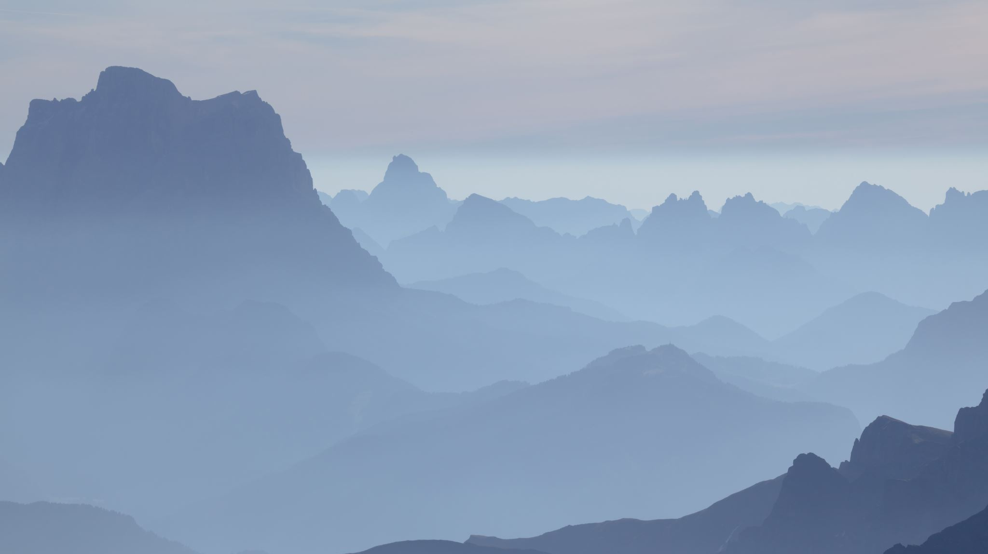
Quiz show game

Slide 2
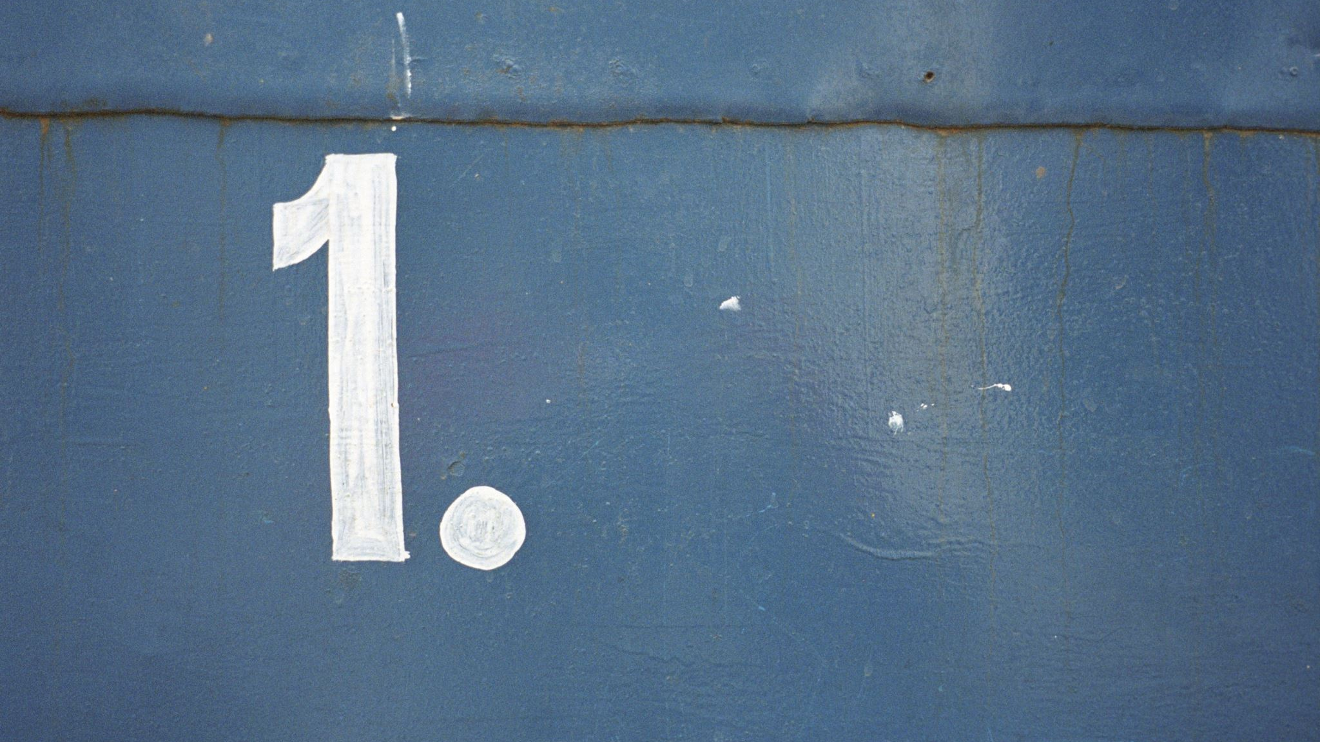
Round 1

Slide 3
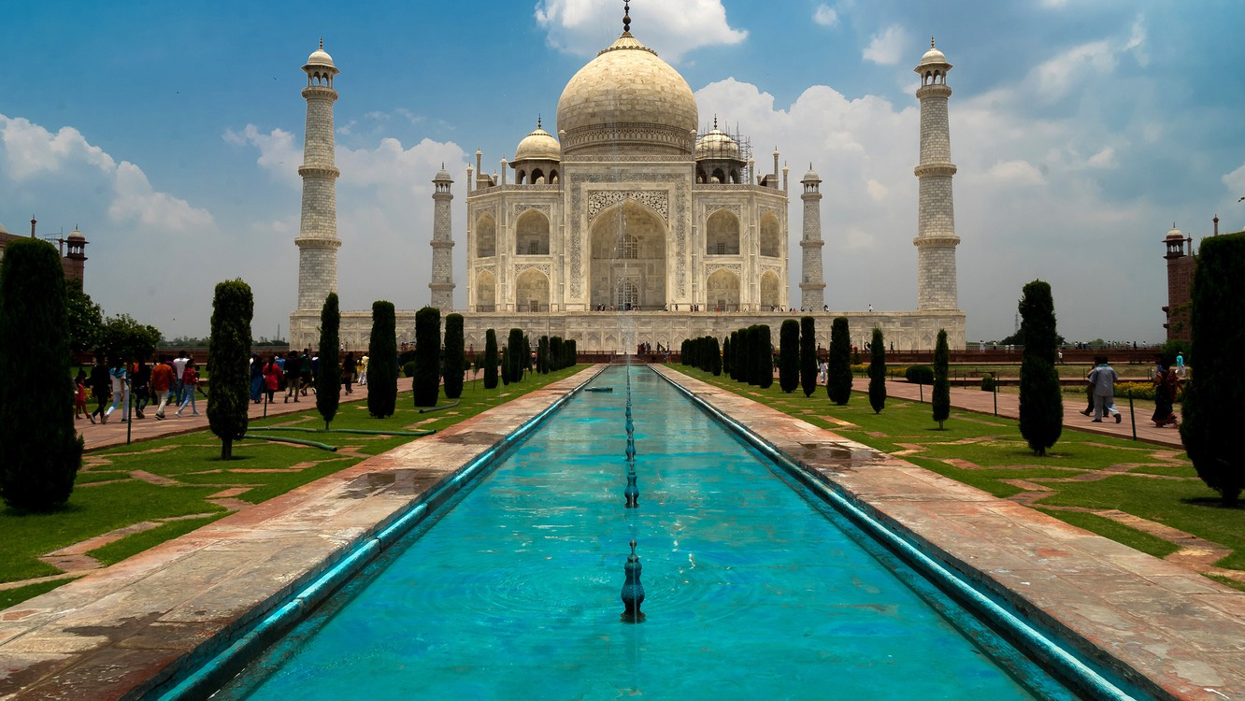
In which country is the Taj Mahal?

Slide 4
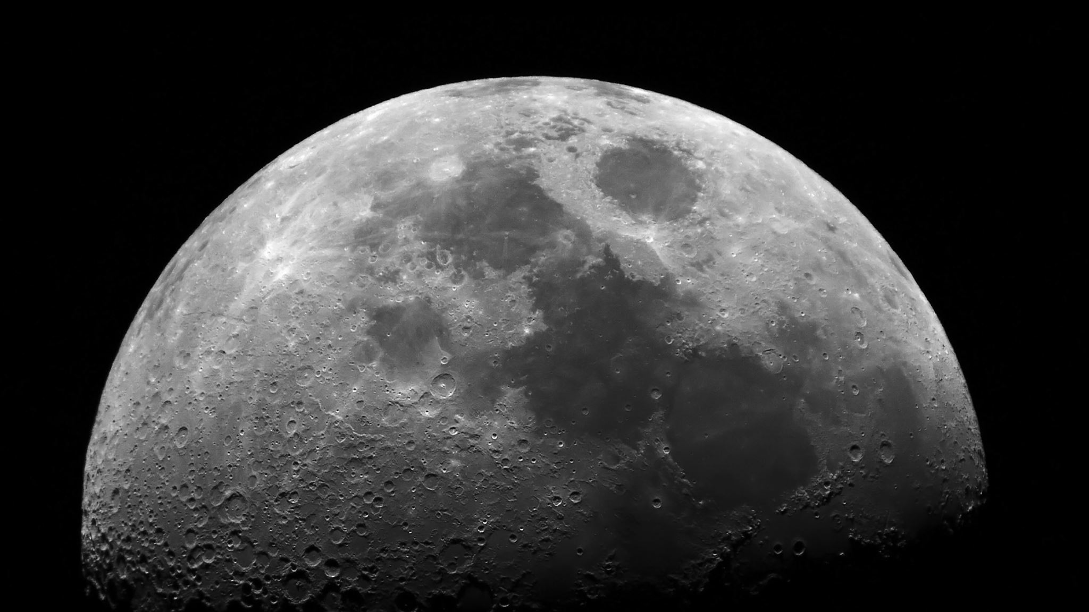
Who was the first man to walk on the moon?

Slide 5
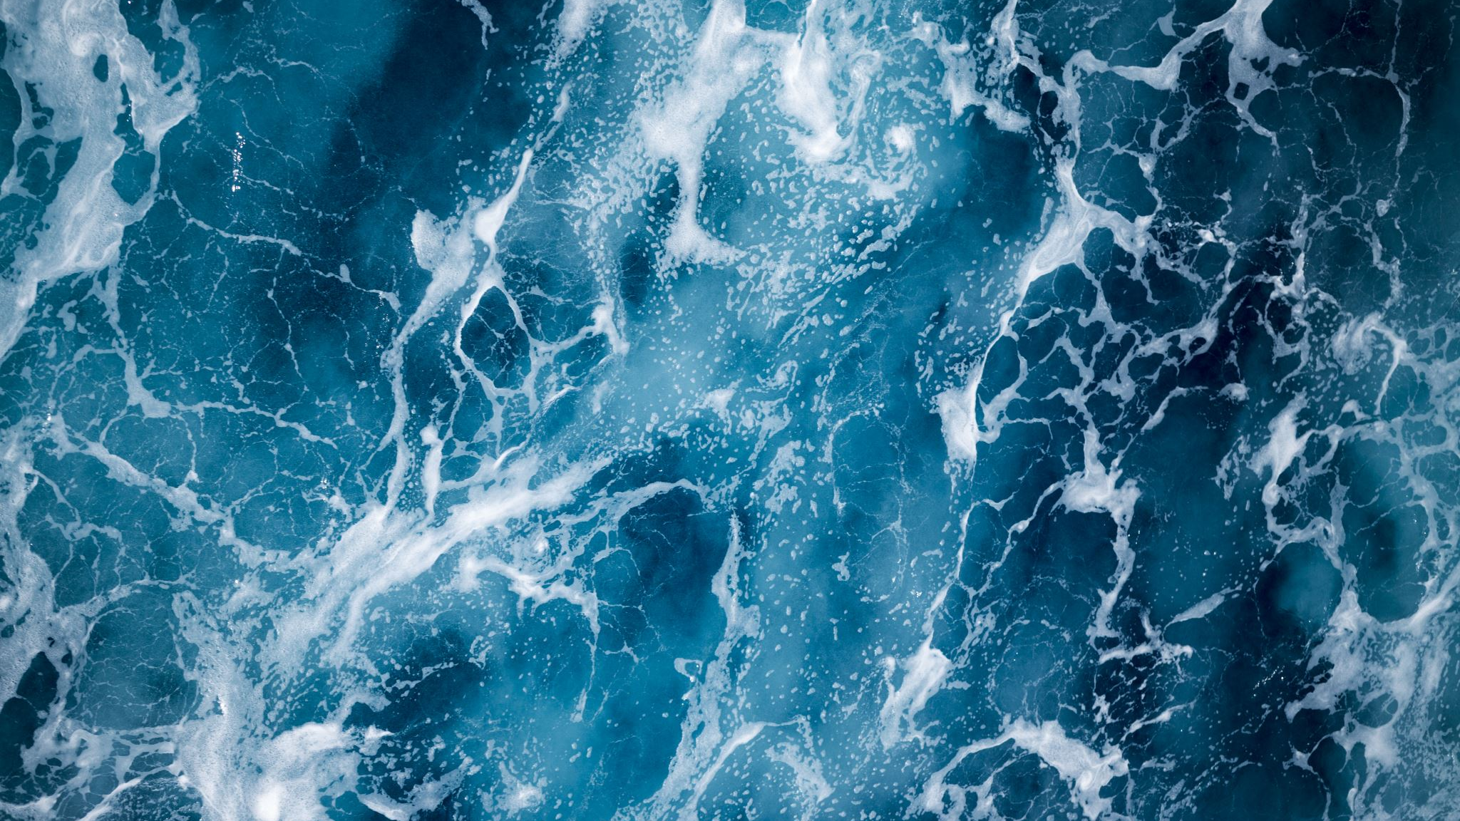
What are the four oceans called?

Slide 6
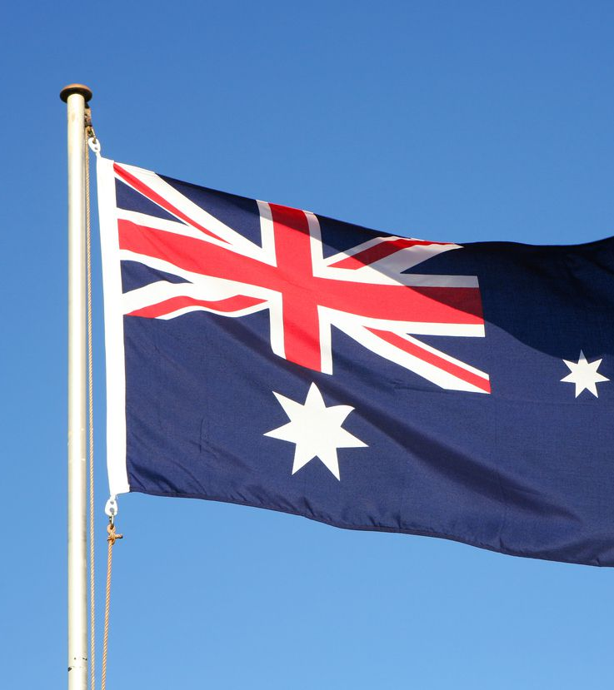
Which language is spoken in Australia?

Slide 7
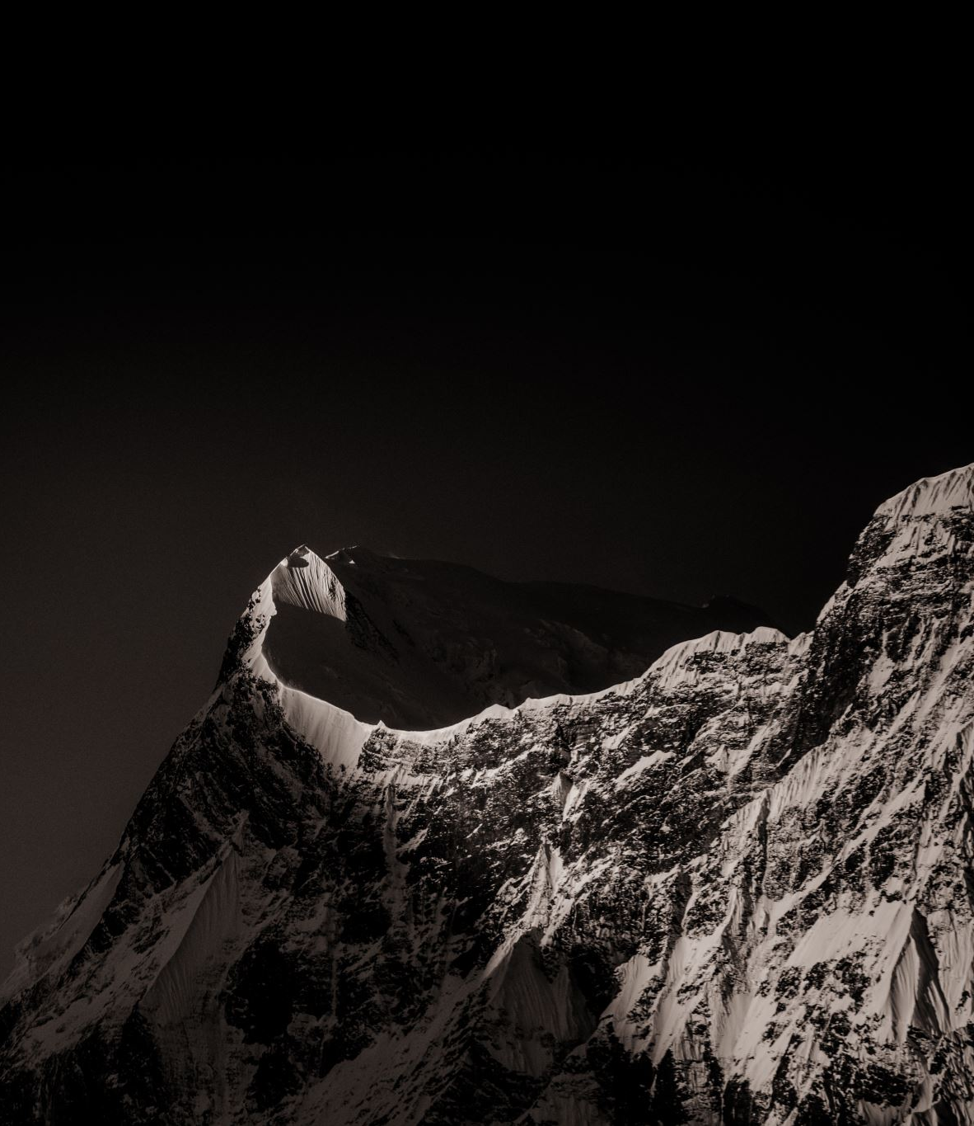
What is the highest mountain in The world?

Slide 8
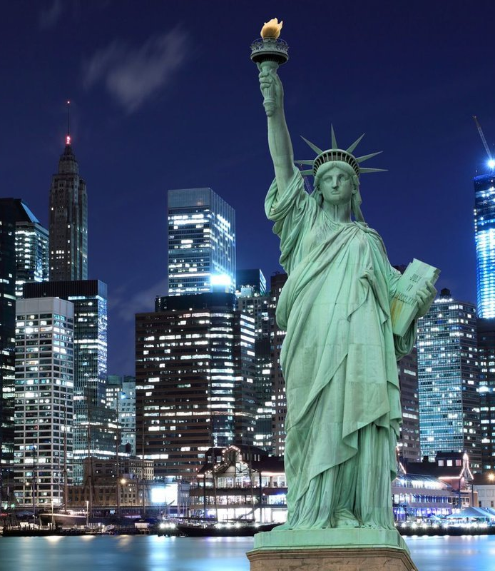
What is the capital of the USA?

Slide 9
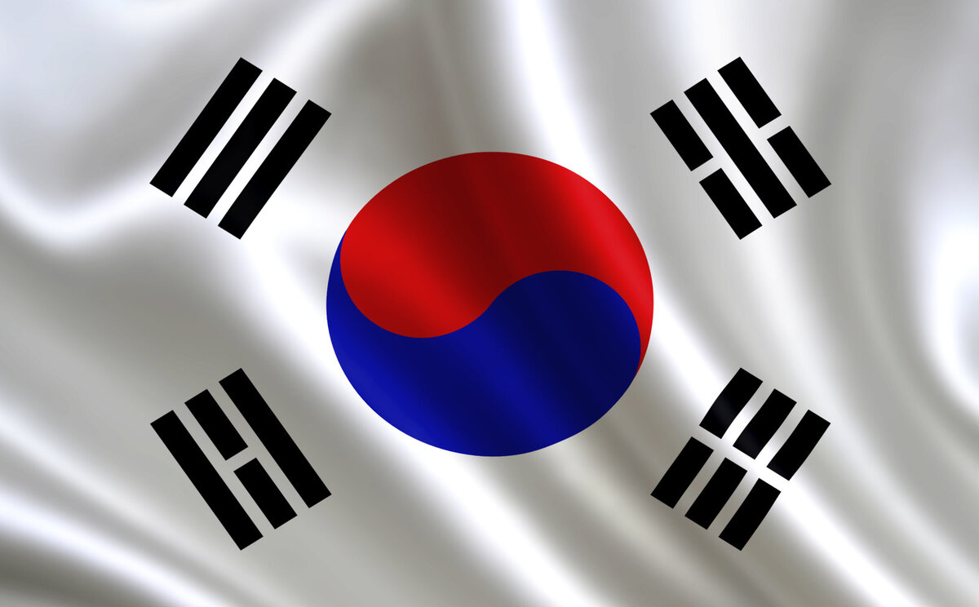
What country does this flag belong to?

Slide 10
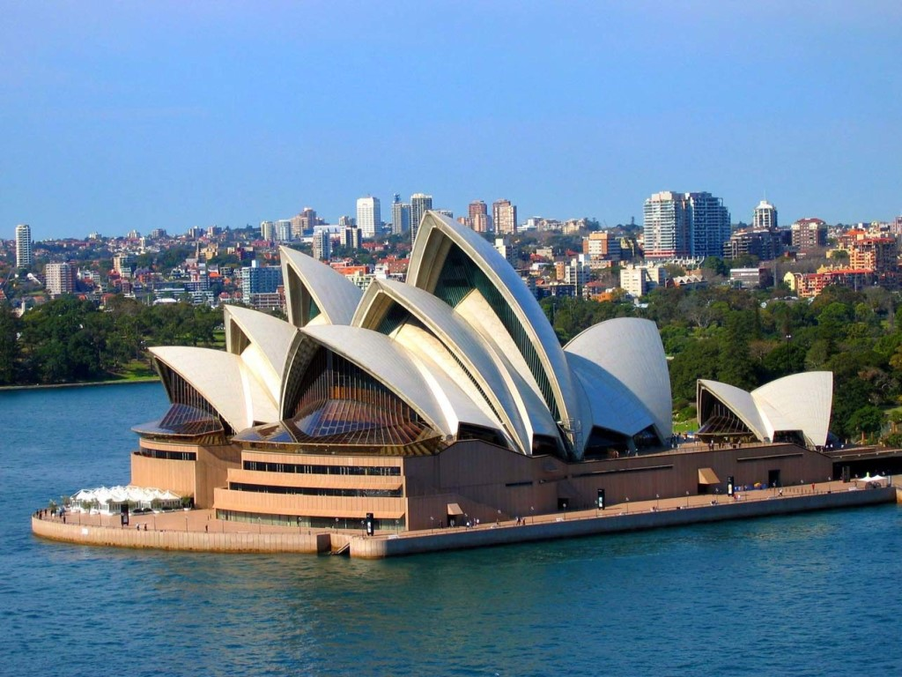
Name the following city and country

Slide 11
On which continent is India located?

Slide 12
How many hours are there in two days?

Slide 13
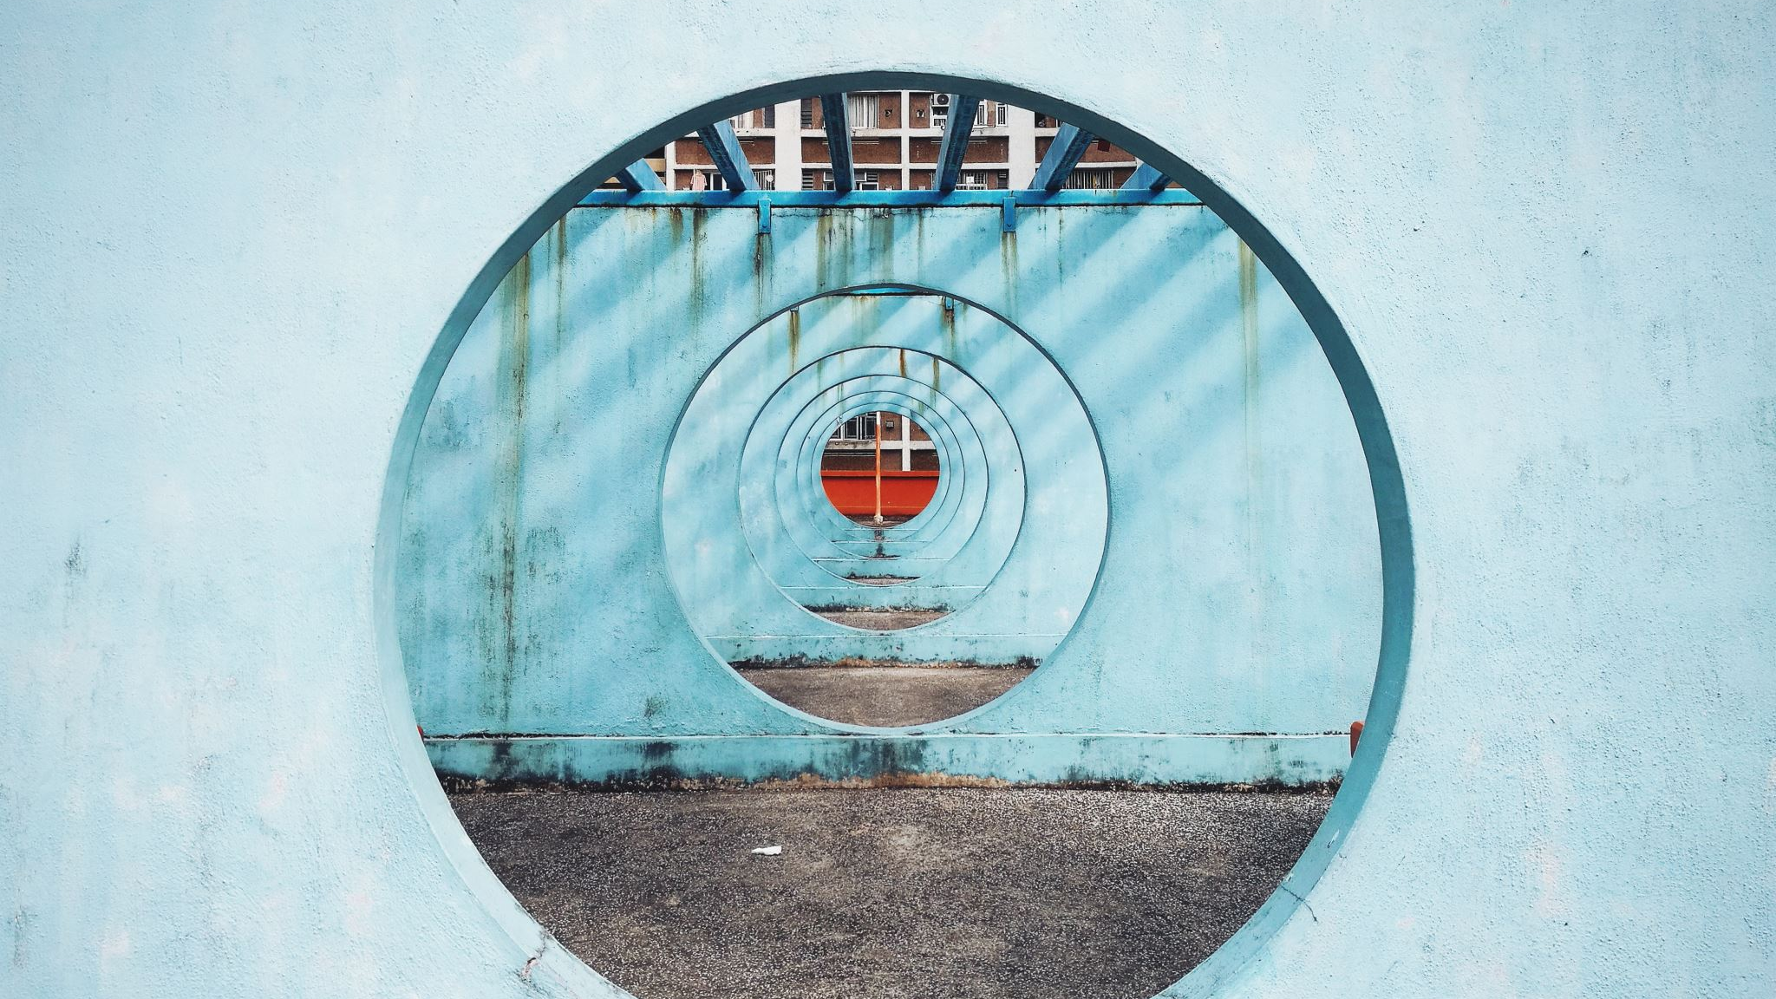
ROUND 2

Slide 14
In which year did the Second World War end?

Slide 15
What is the name of the organ that pumps blood around the body?

Slide 16
What two colours make up the flag of Spain?

Slide 17
In which country are the Pyramids of Giza?

Slide 18
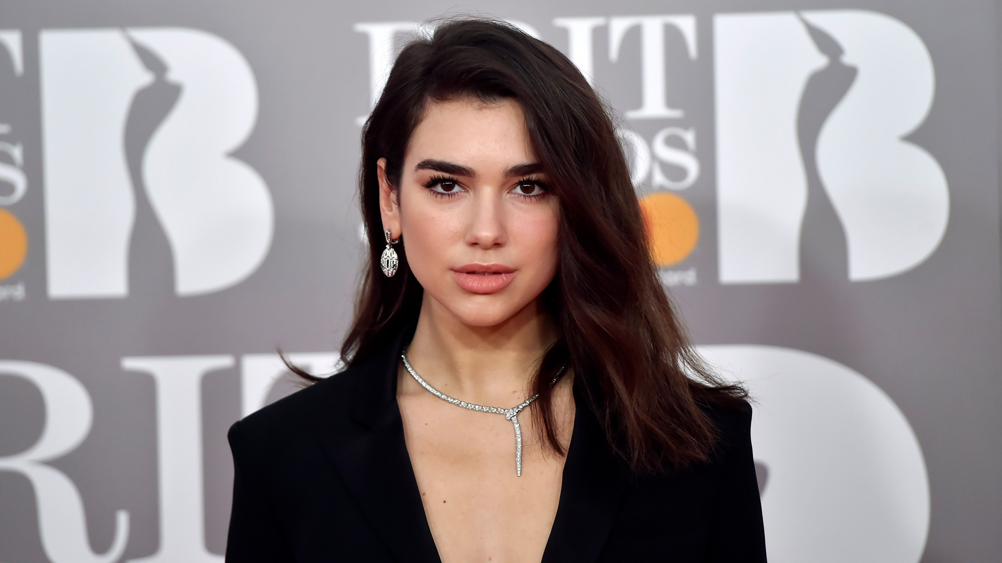
Describe the appearance

Slide 19
In which sport was Muhammad Ali a world champion?

Slide 20
How many teeth should an adult have including their wisdom teeth?

Slide 21
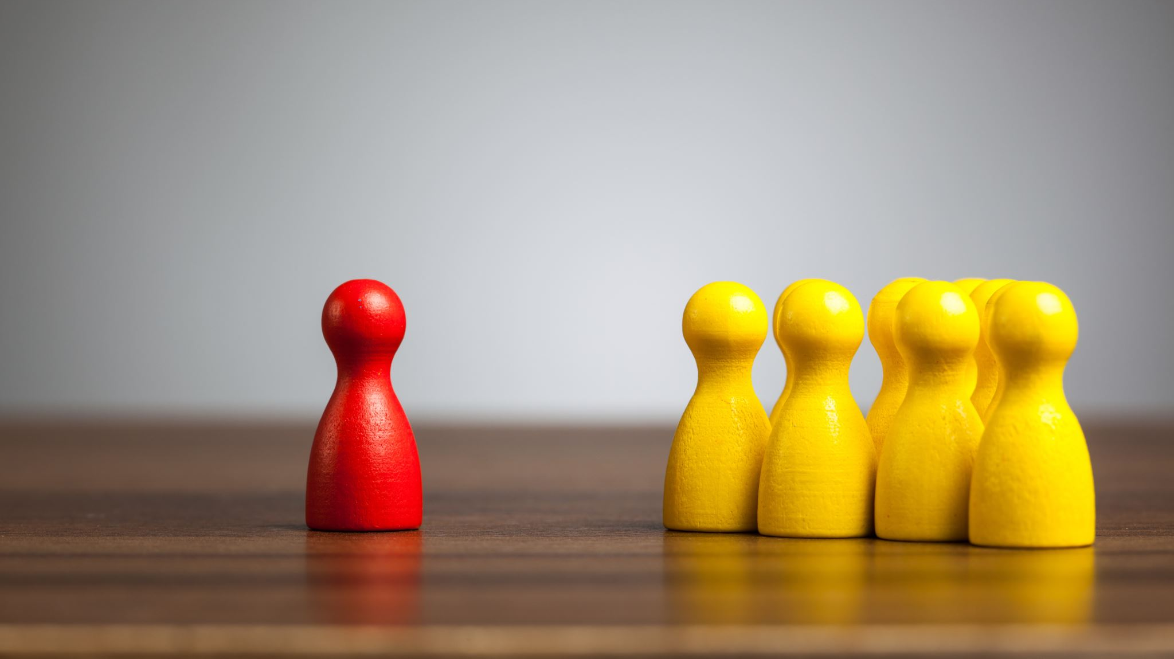
How many years are there in a millennium?

Slide 22
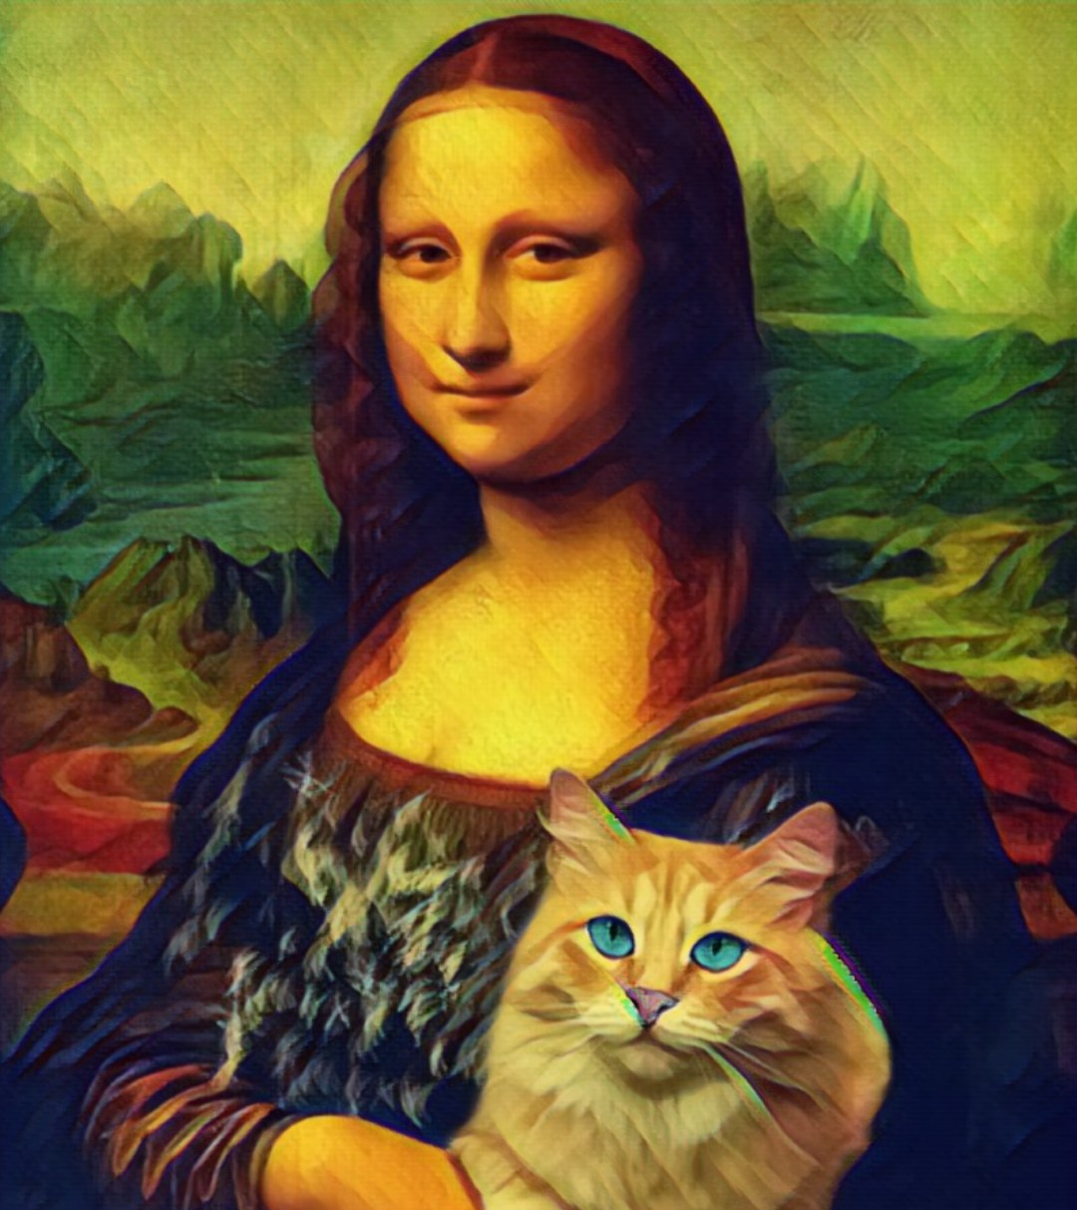
Which artist painted the Mona Lisa?

Slide 23
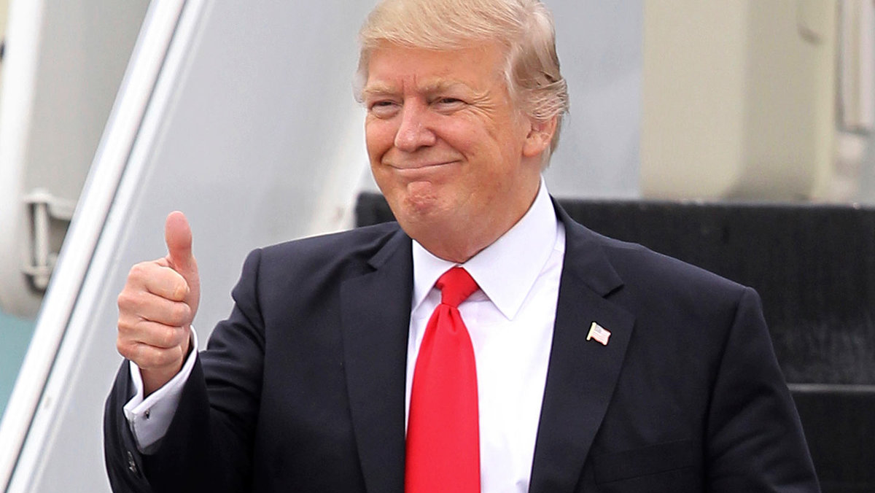
What is the official residence of the President of the United States?

Slide 24
ROUnd 3

Slide 25
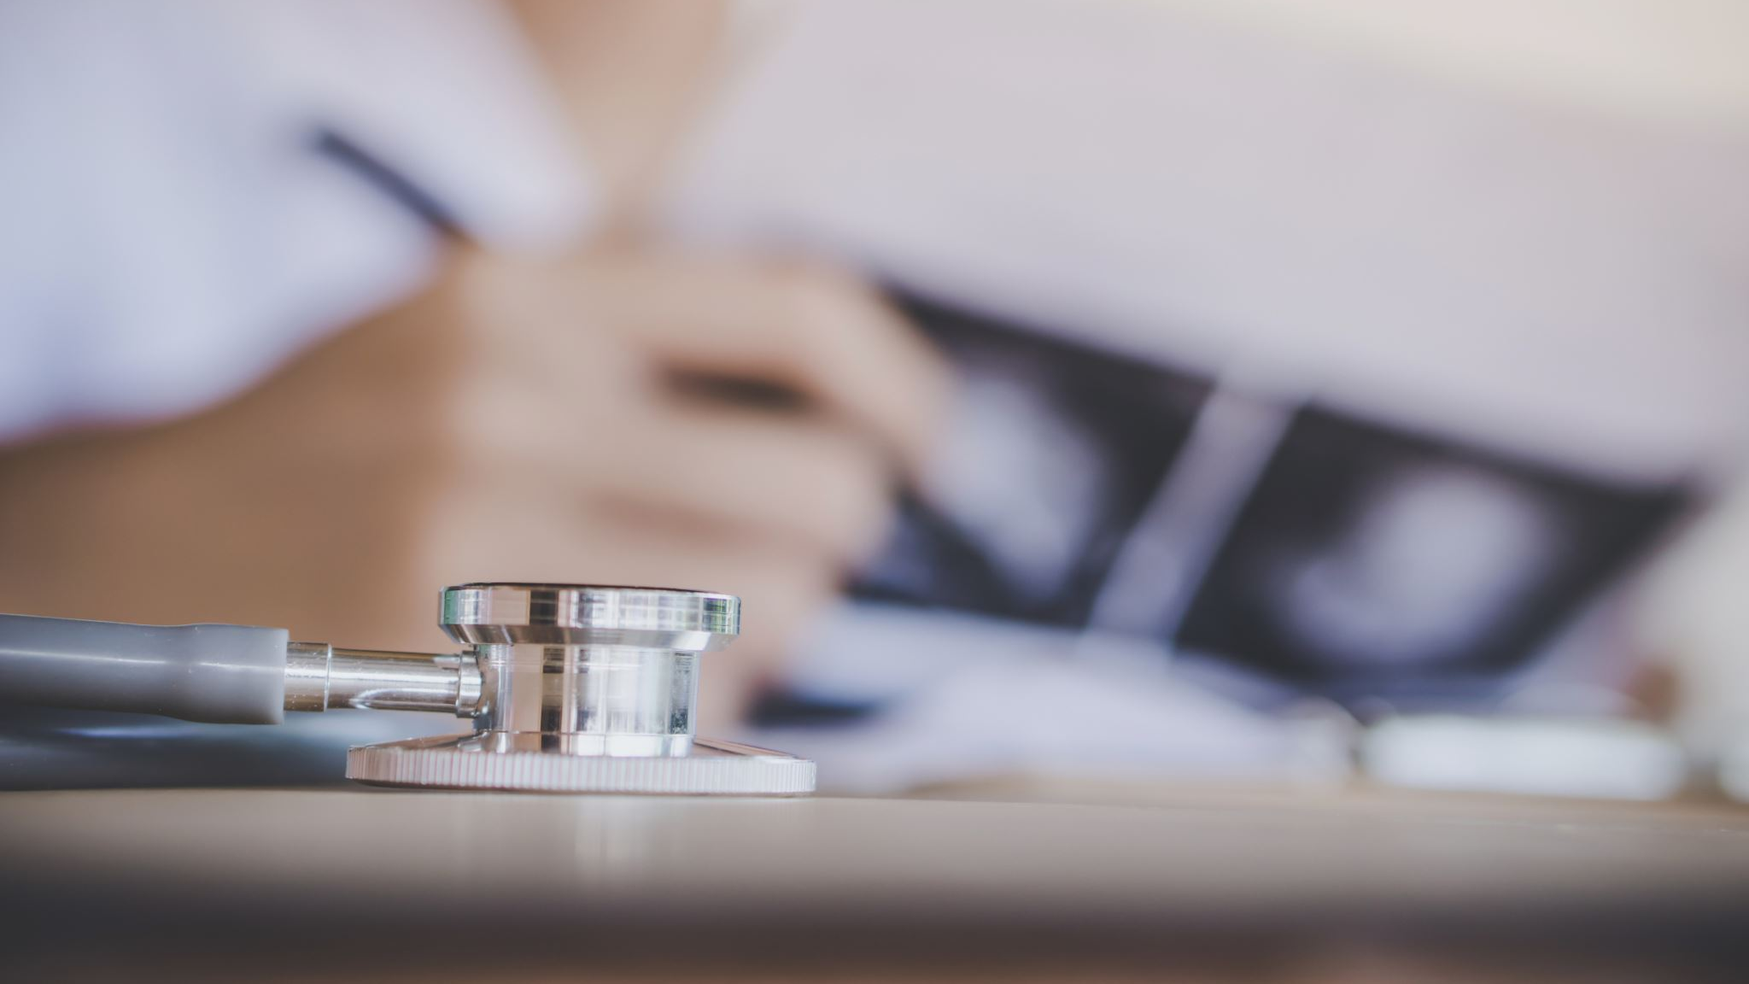
What instrument does a doctor use to find out if a person has a fever?

Slide 26
What does a botanist study?

Slide 27
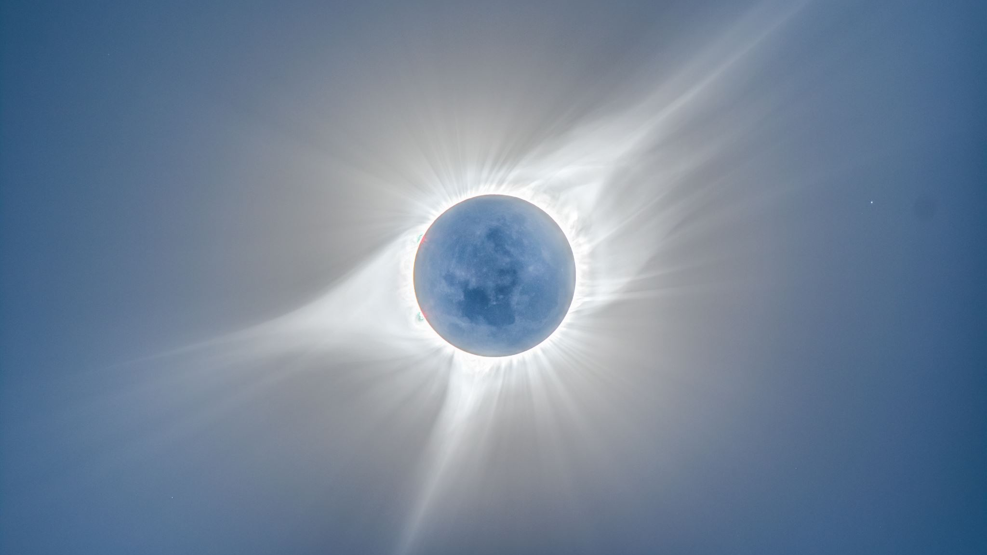
What is the third planet from the sun?

Slide 28
Which ocean is frozen for most of the year?

Slide 29
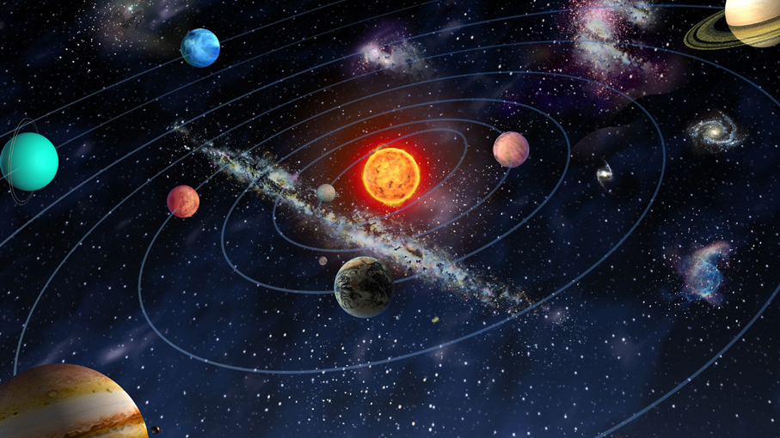
What is the largest planet in the solar system?

Slide 30
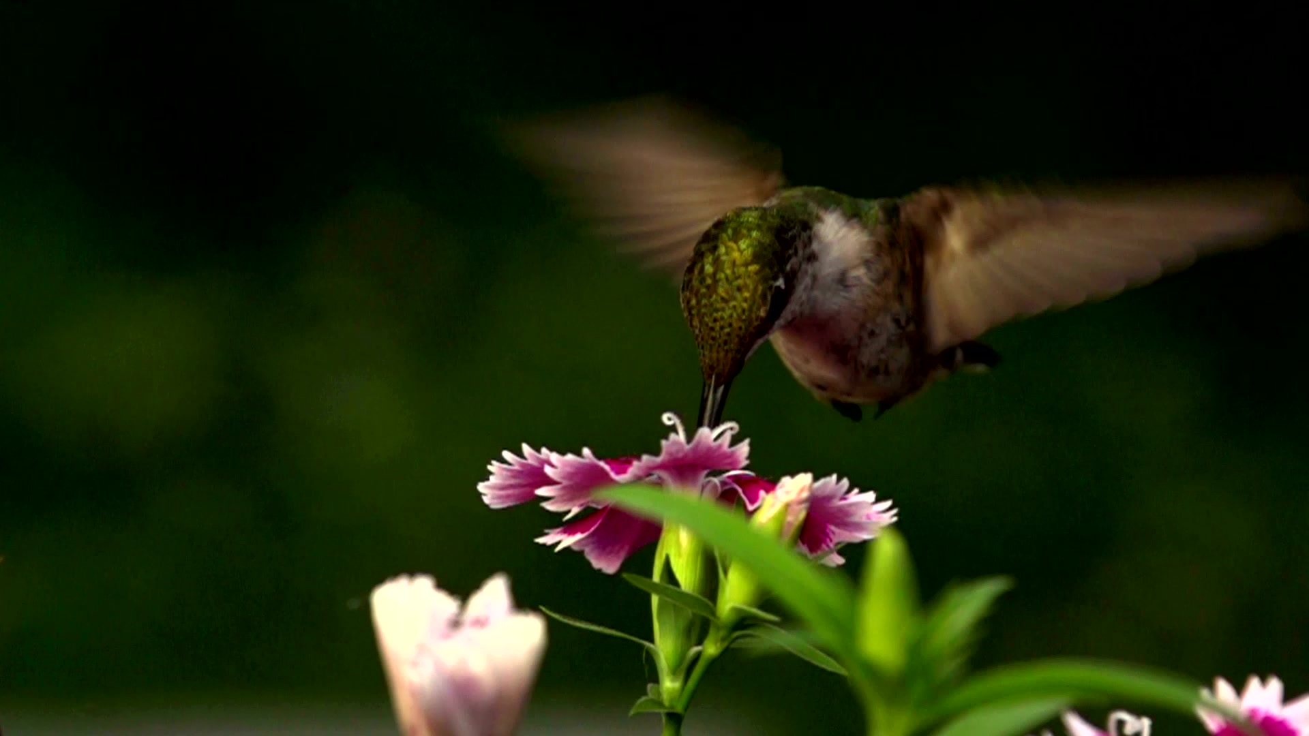
What magical item does Alladin use to fly on?

Slide 31
Which country is Buenos Aires the capital city of?

Slide 32
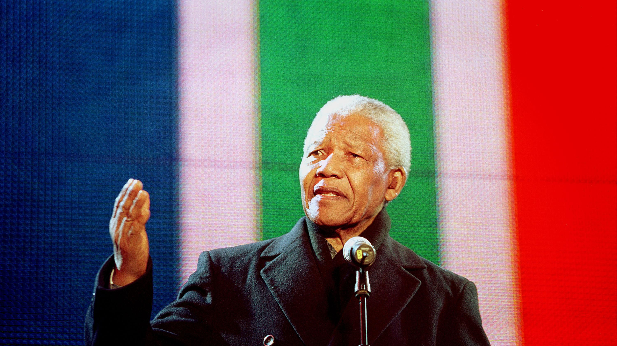
Of what African country was Nelson Mandela president?

Slide 33
Which planet is closest to the sun?

Slide 34
In which country is the Louvre Museum?
a) France b) Italy c) Spain

Slide 35
Which is the largest desert in the world?
a) Sahara b) Gobi c) Arctic

Slide 36
Where is the smallest bone in the human body?
a) In the ear b) In the foot c) In the nose

Slide 37
ThE FiNAL round

Slide 38
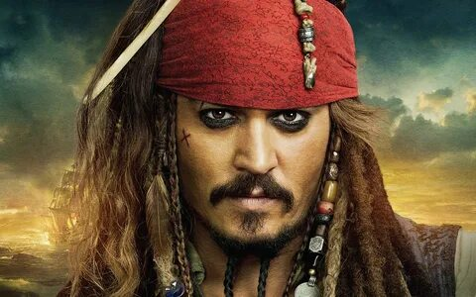
Jack Sparrow

Slide 39
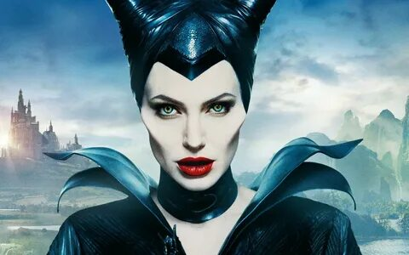
Maleficent

Slide 40
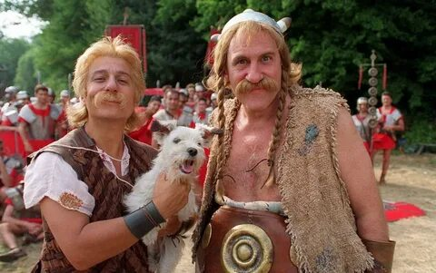
Astérix and Obélix

Slide 41
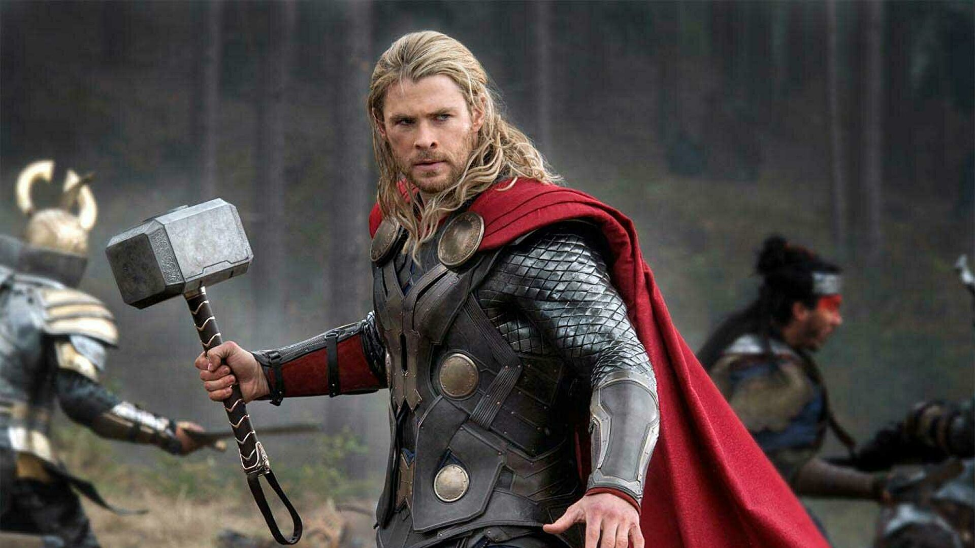
Thor

Slide 42
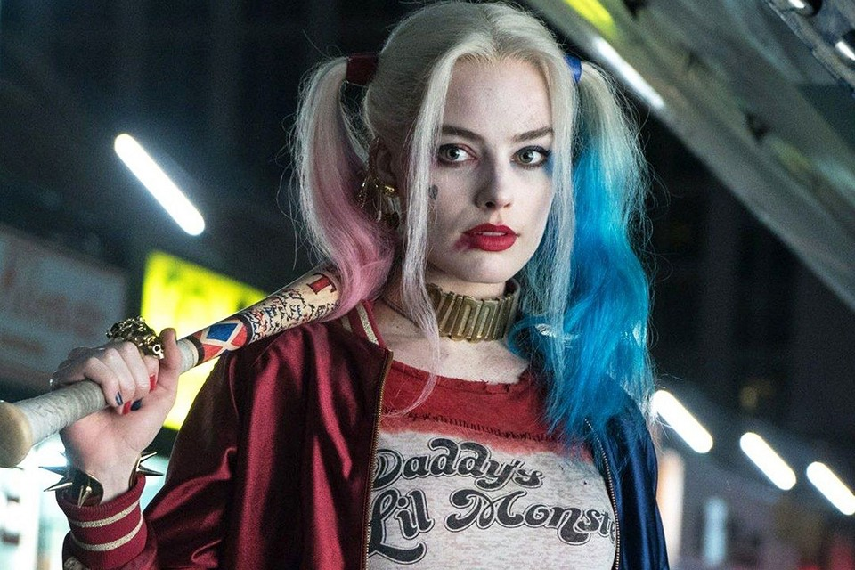
Harley Quinn

Slide 43
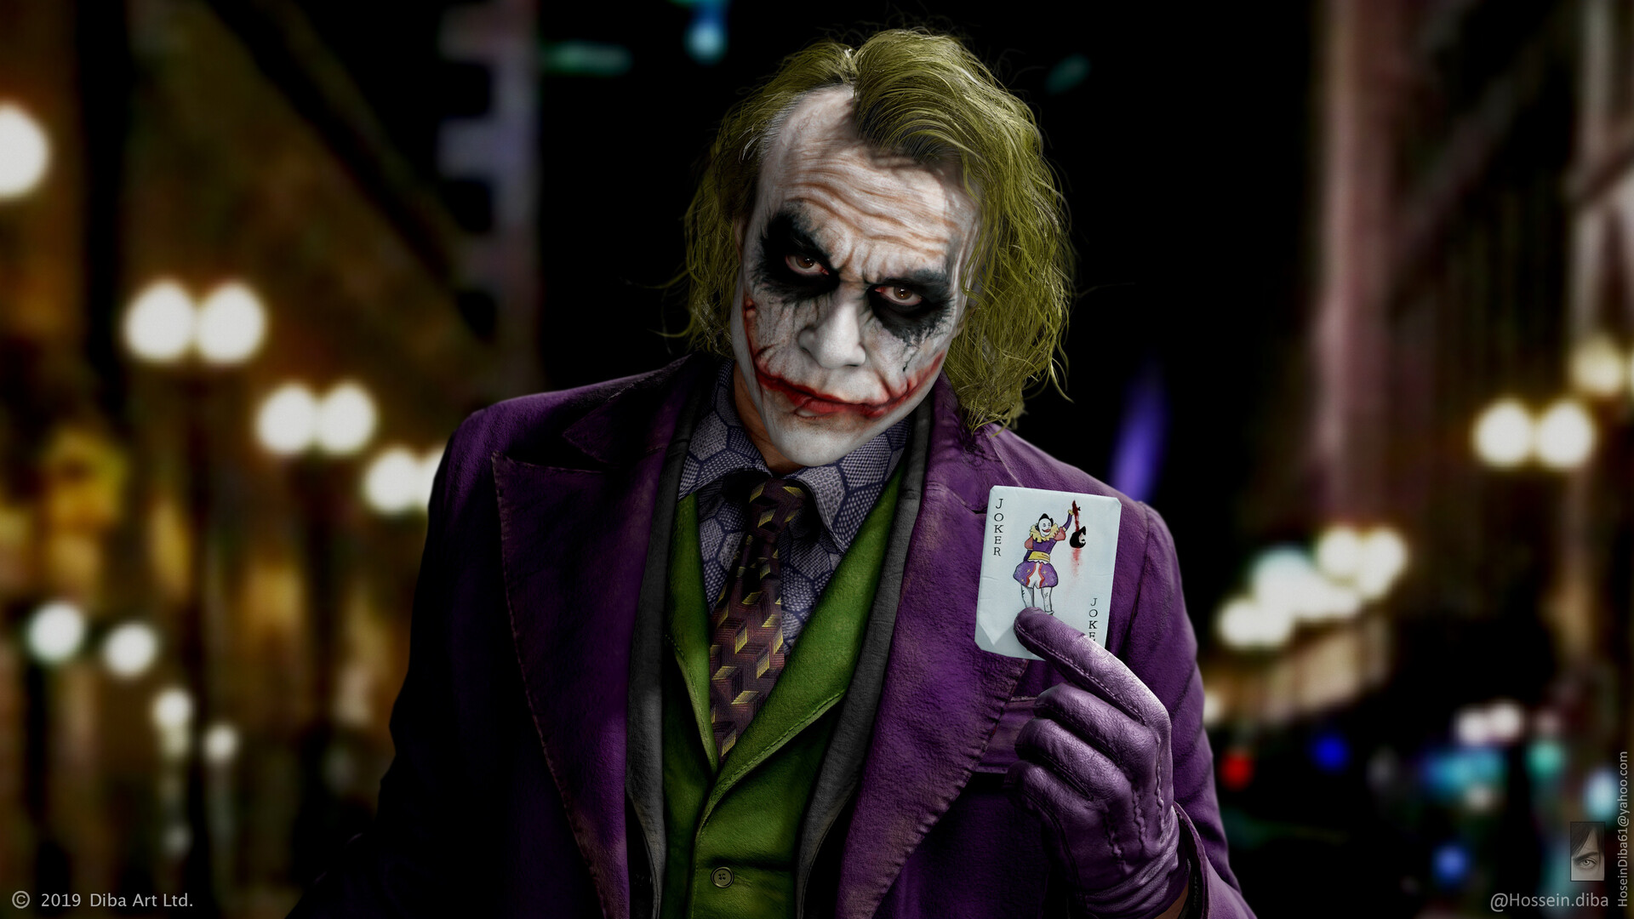
Joker

Slide 44
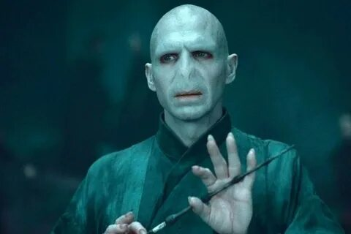
Lord Voldemort

Slide 45
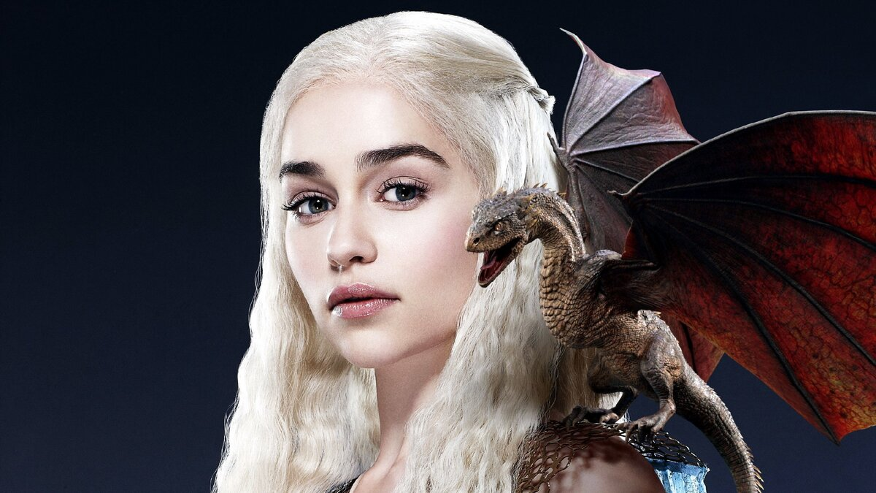
Daenerys Targaryen

Slide 46
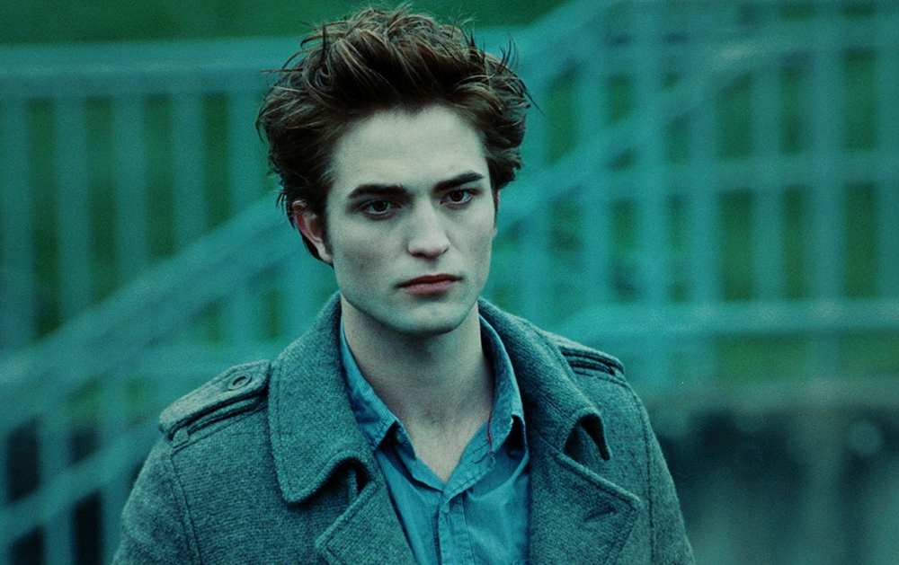
Edward Cullen

